Slide 1
MATH60025/MATH70025: 2024-2025 Hyperbolic PDEs – Linear advection equation
Computational Partial Differential
Equations

Slide 2
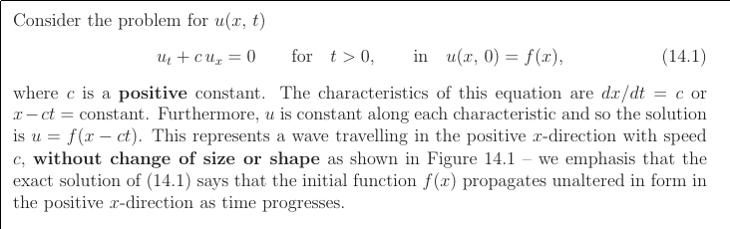
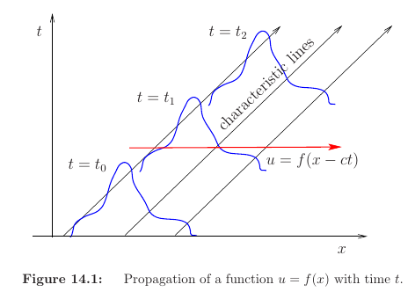
Consider the linear advection equation for u(x,t) :

Slide 3
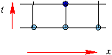
A key parameter:
Courant number, or
Courant-Friedrichs-Lewy (CFL) number:

Slide 4
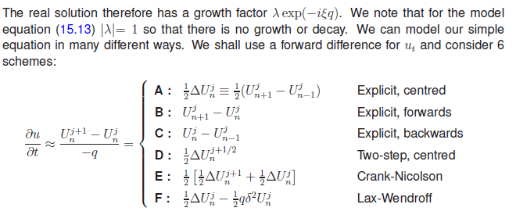

Slide 5
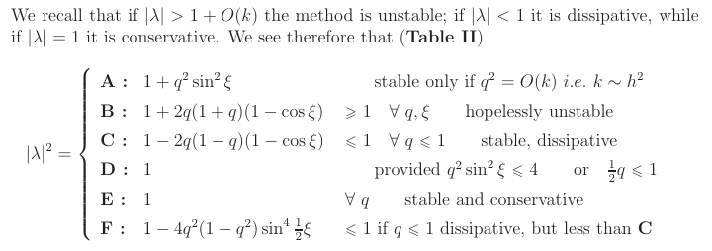
Von-Neumann Fourier Stability analysis:

Slide 6
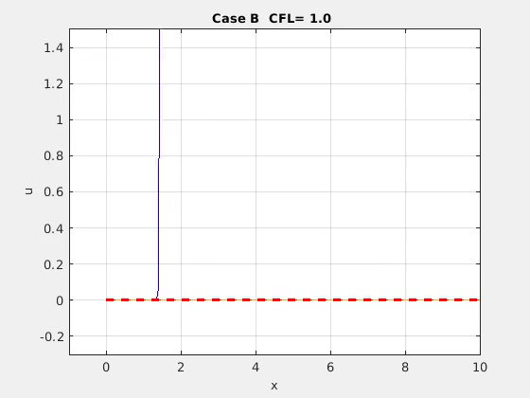
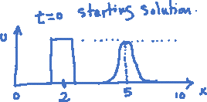
U = 1
Expected solution with time :

Slide 7
Case C : CFL=1.0

Slide 8
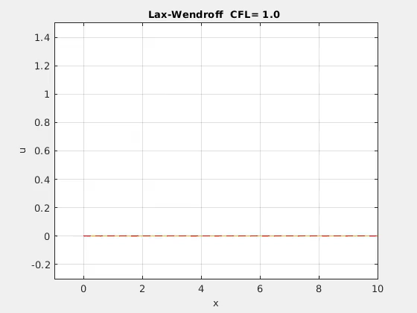
Case F : Lax-Wendroff : CFL=1.0

Slide 9
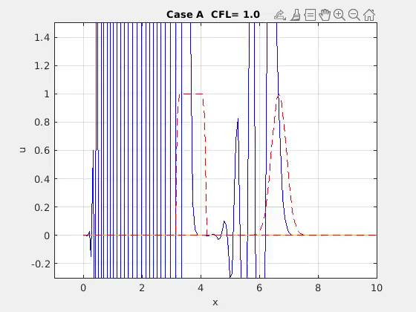
Case A : CFL=1.0

Slide 10
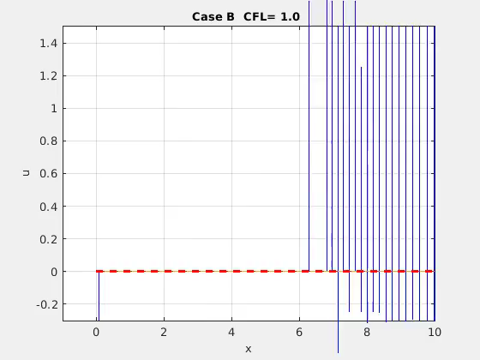
Case B : CFL=1.0

Slide 11
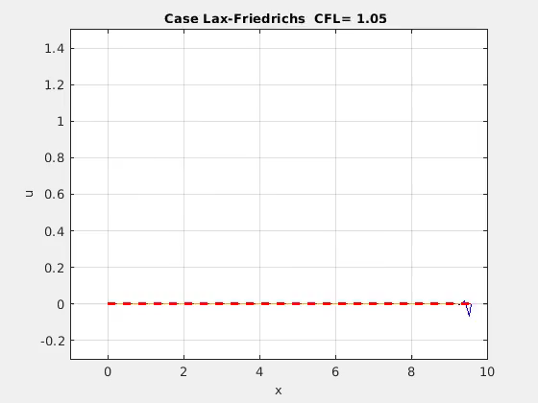
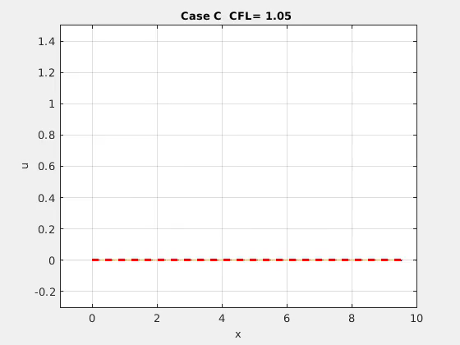
Non-optimal CFL number, CFL > 1
Case C: upwinded, CFL= 1.05
Case F: Lax-Wendroff, CFL= 1.05
Case C : CFL=1.05
Case F : Lax-Wendroff : CFL=1.05

Slide 12

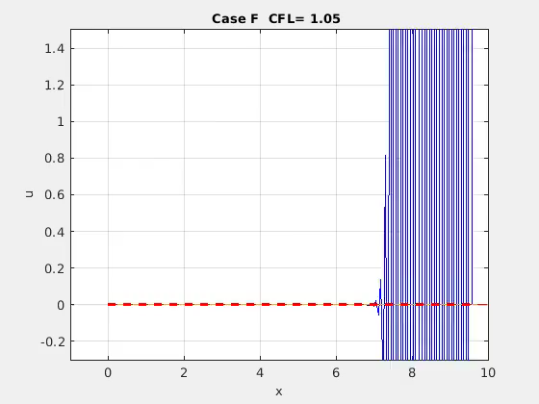
Non-optimal CFL number, CFL < 1
Case C: upwinded, CFL= 0.95
Case F: Lax-Wendroff, CFL= 0.95
Case C : CFL=0.95
Case F : Lax-Wendroff : CFL=0.95

Slide 13
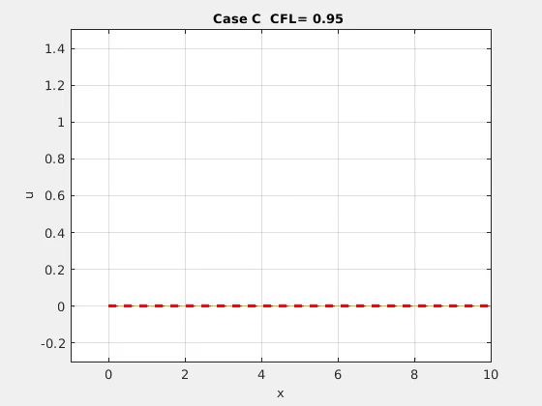
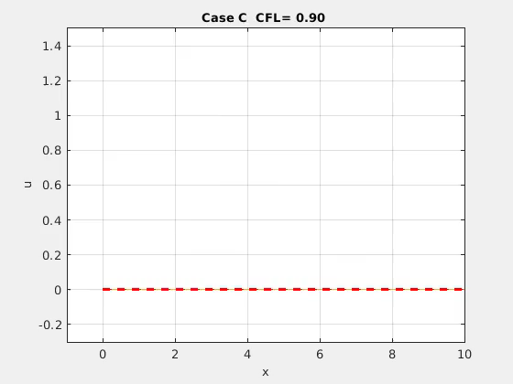
Non-optimal CFL number, CFL < 1
Case C: upwinded, CFL= 0.90
Case F: Lax-Wendroff, CFL= 0.90
Case C : CFL=0.90
Case F : Lax-Wendroff : CFL=0.90

Slide 14
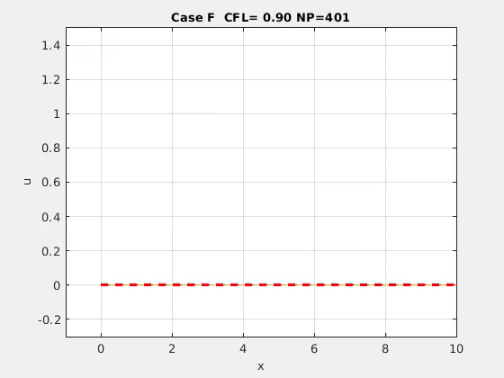
Non-optimal CFL number, CFL < 1, Spatial resolution effect
Case C: upwinded, CFL= 0.90
Case C : CFL=0.90
Case C : CFL=0.90

Slide 15
Non-optimal CFL number, CFL < 1, Spatial resolution effect
Case C: upwinded, CFL= 0.90
Less dissipation
Case C : CFL=0.90
Case C : CFL=0.90

Slide 16

Non-optimal CFL number, CFL < 1, Spatial resolution effect
Case F: Lax-Wendroff, CFL= 0.90
Even lesser dissipation.
Dispersive effect more localised
Less dissipation compared with case C – but dispersive effects!
Case F : Lax-Wendroff : CFL=0.90
Case F : Lax-Wendroff : CFL=0.90

Slide 17
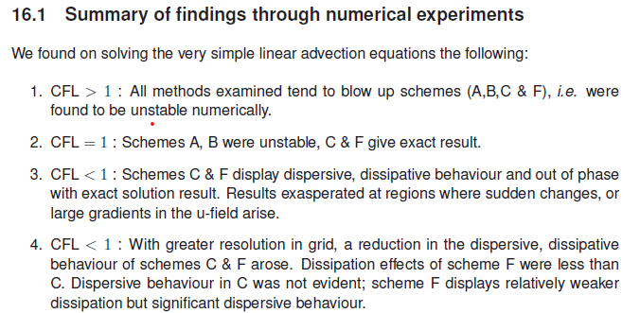
Summary of findings through numerical experiments:

Slide 19
Numerical solutions exhibit:
Advection
Dissipation
Dispersion
Phase Differences

Slide 20
Example of Dissipation (or Diffusion) :
The parabolic one-dimensional heat equation
The solution can be written as
which can be derived using Fourier transform analysis. The variable denotes the Fourier transform of the initial data with ξ as the spatial wavenumber. Physically, the above solution asserts that the oscillatory components in the initial data of wavenumber ξ decay at a rate of . The solution will then be composed of increasingly smooth wave components

Slide 21
Example of Dispersion :
The one-dimensional Schroedinger equation
The solution can be written as
Dispersion is observed in the form of solutions that (rather than decaying as t → ∞, as for the heat equation) break into oscillatory wave packets.

Slide 22
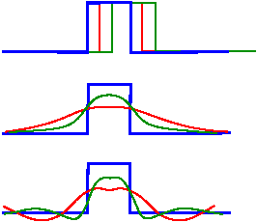
+c
Numerical solutions exhibit :
Advection
Advection
Dissipation
Dispersion
Phase Differences
Dissipation
Dispersion
The three mechanisms of advection, diffusion, and dispersion are central to the behaviour of partial differential equations and their discrete models, and together account for most linear phenomena. The study of numerical methods for these equations reveals many of the issues that come up repeatedly in more difficult problems.
The derivative terms in the advection , diffusion and dispersion
operators play a crucial role, both in terms of accuracy and in terms of the stability of the discretized scheme.

Slide 23
Modified Equation :
Solutions of finite-difference schemes applied to partial differential equations are thought of as approximations to the exact solutions of the continuous problem. Our finite difference solutions to the linear advections equation display dispersive, dissipative effects in addition to displaying phase difference in the evolution of the solution with time, especially when CFL < 1. Why is this? Since the linear advection equation does NOT have either the or operators!
Let us consider, the up-winded scheme C :

Slide 24
We discretised with up-winded scheme C: but in actual fact we are solving numerically the modified equation:
Further reading: Leveque chapter 10

Slide 25
We discretised with up-winded scheme C: but in actual fact we are solving numerically the modified equation:
In a similar manner, Lax-Wendroff scheme F :
The modified equations is:
Uxxx term leads to dispersive behaviour, rather than dissipation.
Magnitude of error smaller than up-winded scheme C. Since F is a higher-order method.
Dispersive term gives rise to oscillating solution and also a shift in main peak location, i.e. phase error.
Further reading: Leveque chapter 10

Slide 26
Summary of findings through numerical experiments :
CFL > 1: all methods examined tend to blow up (A,B,C & F) (i.e. unstable numerically).
CFL=1: A, B unstable, C & F give exact result.
CFL < 1: C & F display dispersive, dissipative behaviour and out of phase with exact solution result. Results exasperated at regions where sudden changes, or large gradients in the u-field arise.
CFL < 1: Greater resolution in grid, reduces the dispersive, dissipative behaviour of C & F. Dissipation effects of F less than C. Dispersive behaviour in C not evident; F displays relatively weaker Dissipation but significant Dispersive behaviour.
Modified equations, schemes C & F

Slide 27
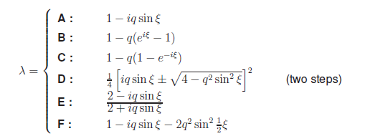
Von-Neumann Fourier Stability analysis:

Slide 28
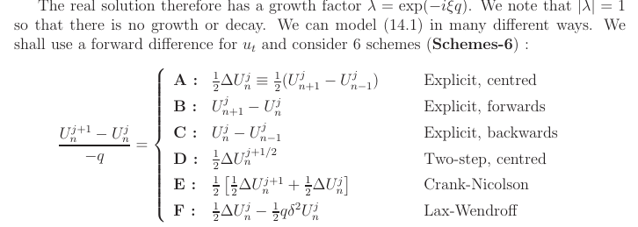
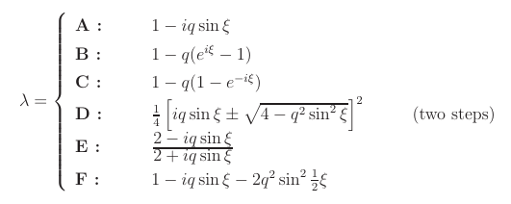
Von-Neumann Fourier Stability analysis:

Slide 29
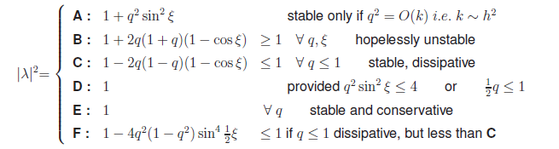
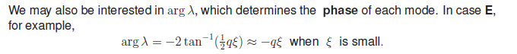
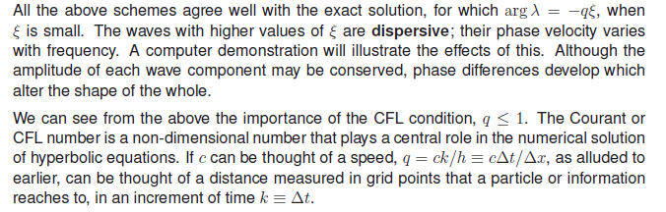
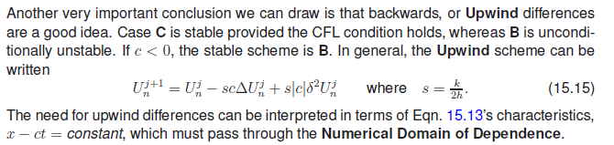

Slide 31
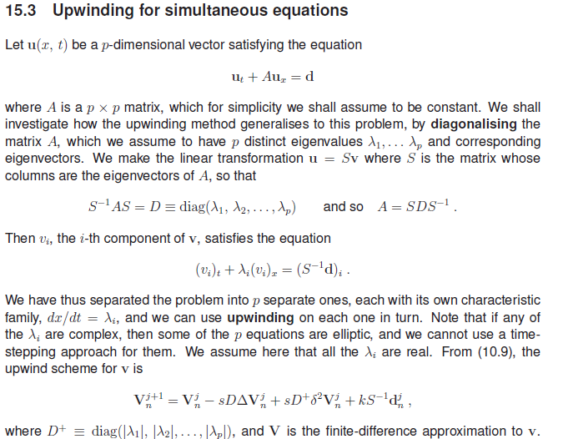

Slide 32
